Slide 1
Implementing Best Practices in Online Learning
11/19/2013
Sherry Grosso
Associate Director of Distributed Learning
University of South Carolina Center for Teaching Excellence
slgrosso@mailbox.sc.edu

Slide 2
Best Practices
Good practice communicate high expectations
Good practice emphasizes time on task
Good practice gives prompt feedback
Good practice encourages student-instructor contact

Slide 3
Best Practices
Good practice encourages student-student cooperation
Good practice encourages active learning
Good practice respects diverse talents and ways of learning

Slide 4
Question
Which fits you?
I have taught or I am currently teaching an online class
I know I will be teaching an online class soon
I am considering teaching an online class

Slide 6
?
?
?

Slide 8
Question
Which fits you?
I use Blackboard
I use D2L

Slide 9
Good Practice Communicates High Expectations

Slide 10
Course Syllabus

Slide 11
Course Syllabus
Course Description
Example:
Course Overview:
This is a fully online course. Online classes are not easier than lecture classes. To succeed in an online class, you must be extremely motivated and well organized. You will need to purchase the required textbooks listed above by the first day of the course. Other course materials are available via Blackboard. Regular Internet access is essential for successful completion of the course.

Slide 12
Course Syllabus
Course Structure
Example:
Overall Structure of the Course:
The typical class structure will consist of weekly modules, which include:
Short Video Lectures
Readings
Group Discussions
Quizzes
Films/YouTube Videos
Analytical Paper

Slide 13
Course Syllabus
Course Learning Outcomes/Objectives
Objectives describe measurable outcomes
What do you want them to know
What do you want them to be able to do

Slide 14
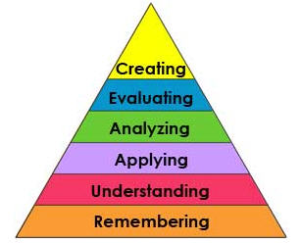
Outcomes/Objectives
Avoid vague terms
Use actions verbs
Match levels to course content
http://www.celt.iastate.edu/teaching/RevisedBlooms1.html
http://www.celt.iastate.edu/pdfs-docs/teaching/RevisedBloomsHandout.pdf
http://ww2.odu.edu/educ/roverbau/Bloom/blooms_taxonomy.htm

Slide 15
Course Syllabus
Course Requirements
Activities/Assignments/Assessments
Grading/Grading Scale
Contact Information
Student Support Services

Slide 16
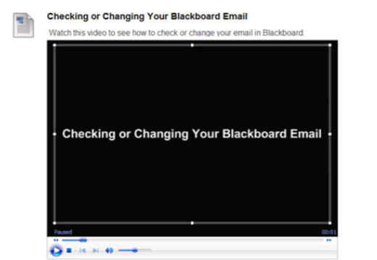
Course Syllabus
Technical Requirements & Support
Short ‘help’ videos
Checking Bb email in Blackboard
Submitting assignments
Discussion Board posting
Taking a quiz or test

Slide 17
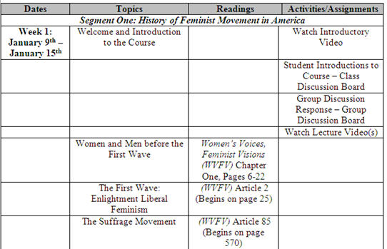
Course Syllabus
Course Schedule
Students’ Perspective
What will they have to do and when they will have to do it
How they meet the objectives

Slide 18
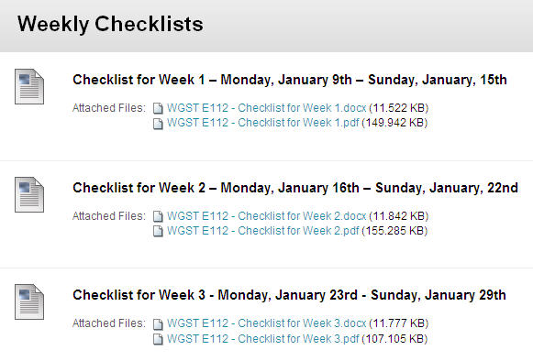
Course Syllabus
Course Schedule
Weekly checklists

Slide 19
Good Practice Communicates High Expectations
Tests – ‘Lower the Stakes’
Draw from pools
Randomize
Single question
No backtracking

Slide 20
Good Practice Communicates High Expectations
Timed correctly
Only submitted answers
Close modules/materials
Honor Code still applies
Narrated review of results

Slide 21
Good Practice Communicates High Expectations
Grading:
Use rubrics and provide copies to students
More consistent and efficient when grading
Helps students focus their efforts
Helps minimize subjectivity

Slide 22
Good Practice Communicates High Expectations
Design your rubric around the learning outcomes of the assignment
The weight of various components should reflect the learning outcomes
Prepare model answers before you begin grading

Slide 23
Good Practice Communicates High Expectations
You determine what you expect of the students
Make it clear to them what your expectations are
Include these on your Syllabus

Slide 24
Good Practice Communicates High Expectations
Examples:
Students must have daily access to a computer with reliable Internet access and e-mail.
Assignments for the class will be available through Blackboard. File formats used are PowerPoint, Word, and .pdf. You will need PowerPoint and Word to use the assignment files and Adobe Acrobat Reader to use the .pdf files.

Slide 25
Good Practice Communicates High Expectations
Examples:
Students must be reachable by email until final grades are posted.
The Professor will be using the email address listed in Blackboard. It is the student’s responsibility to check that email address.

Slide 26
Good Practice Communicates High Expectations
Examples:
Students must keep current with all coursework and materials.
This is not a correspondence course. That means that there are specific due dates for assignments, quizzes and tests. You must watch the deadlines and submit your work on time.

Slide 27
Good Practice Communicates High Expectations
Examples:
How Much Time You Should Spend in Study for this Course? This is an entirely web-based course. We have no face-to-face class meetings, and you will complete your work asynchronously - which simply means that you may be working on it at different times than your colleagues. You can log in to the class to do your work at whatever time is convenient for you as long as you are meeting class deadlines.

Slide 28
Good Practice Communicates High Expectations
Examples:
It is important to understand that this is not a self-paced class or an independent study. You will have weekly deadlines, and work must be submitted on time and will not be accepted late. You may not save up your assignments to complete in the last weeks or days of the semester. One critical part of this class is regular interaction with other students and with me, your instructor.

Slide 29
Good Practice Communicates High Expectations
Examples:
While thinking about your work schedule for this semester, you should plan to spend the same amount of time "in class" and out of class that you would in a traditional class - about three hours each week online interacting with classmates and reading course materials, doing assignments, etc. and about nine outside of class preparing assignments, reading your text, and researching.
Yes, you read that right - you should expect to spend about twelve hours a week working on this class.

Slide 30
Good Practice Communicates High Expectations
Examples:
For this online class, each assignment will contain specific instructions on how it is to be submitted. It is important that the specific instructions are followed for each assignment in order to correctly submit assignments.

Slide 31
Good Practice Communicates High Expectations
Examples:
Assignments, tests and quizzes are to be submitted electronically, and are due by 11:59 PM of the posted due date.
Late assignments, quizzes or tests will not be accepted.

Slide 32
Good Practice Emphasizes Time on Task

Slide 33
Course Navigation
Easy Navigation/User Friendly
Logical, Intuitive, Consistent
Meet the Needs of the Course
Weekly Modules

Slide 34
Good Practice Emphasizes Time on Task
Course Menu
Start Here/Read This First
Course Information
Syllabus
Schedule
Meet Your Professor
Weekly Modules
Discussions

Slide 35
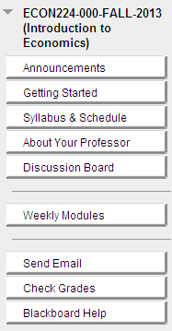
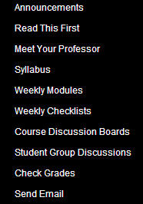
Good Practice Emphasizes Time on Task
Time on Task

Slide 36
Good Practice Emphasizes Time on Task
Clear Course Structure
Introduction to Course
Explain the navigation

Slide 37
Good Practice Emphasizes Time on Task
Use a Syllabus/how the course works quiz

Slide 38
Good Practice Emphasizes Time on Task
Course Menu
Discussions
Student Introductions
‘Analyze’ your learners

Slide 39
Good Practice Emphasizes Time on Task
Discussion Assignments
Course Questions
Reduces e-mails to you
Students not afraid to ‘ask’
Course ‘lounge’ or ‘virtual café’

Slide 40
Good Practice Emphasizes Time on Task
Course Menu
Weekly Modules with Topics, Objectives, Activities

Slide 41
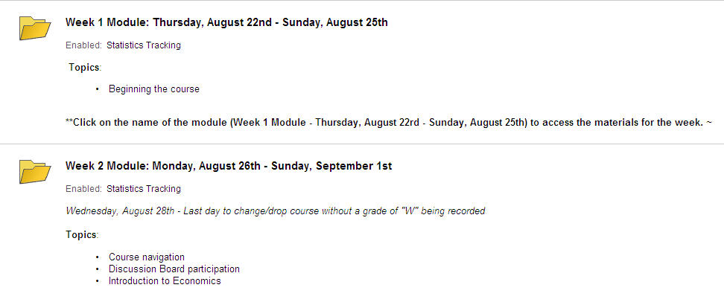
Weekly Modules
Time on Task

Slide 42
Weekly Modules
Time on Task

Slide 43
Weekly Modules
Time on Task

Slide 44
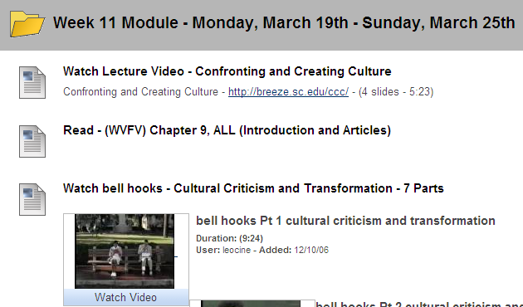
Weekly Modules
Time on Task

Slide 45
Good Practice Emphasizes Time on Task
Provide clear due dates
Provide clear deadlines
Write clear and detailed directions for all student assignments and tasks
More details upfront = fewer questions for you

Slide 46
Good Practice Emphasizes Time on Task
Give students an idea of how long an assignment should take to complete
Use the announcement page throughout the semester

Slide 47
Good Practice Emphasizes Time on Task
Give students reminders about assignments, quizzes, tests due
Design tasks that accomplish more than one purpose

Slide 48
Good Practice Gives Prompt Feedback
Tell students when assignments will be graded
Use auto-graded quizzes and assignments
Allow students to submit drafts for feedback before final submission

Slide 49
Good Practice Gives Prompt Feedback
Use practice quizzes and multiple attempts
Help student assess their understanding of the material

Slide 50
Good Practice Gives Prompt Feedback
Respond to the class as a whole
Weekly Intros
Weekly Wrap-Ups
Created as announcements and/or short recordings

Slide 51
Good Practice Encourages Student-Instructor Contact
Include an instructor bio/video
Professional information
Personal information
Picture
Use “I”

Slide 52
Good Practice Encourages Student-Instructor Contact
Include a welcome message/introductory video
Include regular announcements/remain ‘present’
Consider virtual office hours

Slide 53
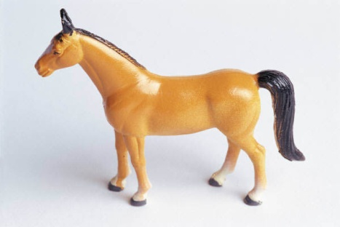
Good Practice Encourages Student-Instructor Contact
Provide clear guidelines for interaction, including:
The Type of Interaction Expected, for example:
Proper e-mails to the instructor will include a greeting such as ‘Hello Professor’ and the student’s name at the end. Starting an email with "Hey" is not appropriate.

Slide 54
Good Practice Encourages Student-Instructor Contact
Provide clear guidelines for interaction, including:
The Type of Interaction Expected, for example:
General questions about the course and assignments should be asked in the Discussion Board forum titled “Questions about the Course”

Slide 55
Good Practice Encourages Student-Instructor Contact
Provide clear guidelines for interaction, including:
The Timeliness of the Contact, for example:
The instructor will respond to e-mails within 24 hours of receipt
The instructor will respond to properly written emails within 48 hours on weekends

Slide 56
Good Practice Encourages Student-Instructor Contact
Provide clear guidelines for interaction, including:
The Tone of the Contact, for example:
Provide ‘netiquette’ guidelines
Respond courteously to student communication
Use students’ names

Slide 57
Good Practice Encourages Student-Instructor Contact
Have formative evaluations two to three times a semester. Ask questions like:
How is the course going?
What do you not understand in the course?
Do you have any suggestions?

Slide 58
Good Practice Encourages Student-Student Cooperation
Have students introduce themselves
Time on Task
Contact

Slide 59
Good Practice Encourages Student-Student Cooperation
Use group projects
case studies, simulations, debates
Use group blogs and wikis

Slide 60
Good Practice Encourages Student-Student Cooperation
Use Engaging Discussion Boards
Focus on specific assignments or topics
Require participation in discussions with clear directions
Require responses to classmates
Define ‘netiquette’ requirements
Provide rubrics for discussion responses
http://www.mtsu.edu/ltanditc/docs/Discussion_Board_Rubrics.pdf

Slide 61
Good Practice Encourages Student-Student Cooperation
Use an open discussion forum for students to ask and answer each other’s questions
Create a discussion forum ‘virtual café’ as a place where students can socialize with each other
Contact

Slide 62
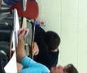
Good Practice Encourages Active Learning

Slide 63
Good Practice Encourages Active Learning
Learning is not a spectator sport
Current Methods
What to continue?
Engage the students
Share your enthusiasm for your subject
What to change?
Transition from ‘sage on the stage’ to facilitator

Slide 64
Good Practice Encourages Active Learning
Include more than just text
Divide material into smaller segments
Create narrated lectures
Plan for (approximately)10 minute lectures
Lectures prompt for further reading
Include interactivity in lectures

Slide 65
Online Lectures
Tools:
Adobe Presenter
Adobe Connect
Adobe Captivate
Camtasia
Jing
Camstudio
Blackboard Collaborate

Slide 66
Online Lectures
Adobe Presenter
Power Point Add-In
Voice Over Power Point
Video/Audio
User Controls
Notes
Interactive Questions

Slide 67
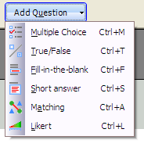
Online Lectures
Quiz Manager

Slide 68
Interactive Lectures

Slide 69
Interactive Lectures

Slide 70
Question
Which fits you?
I use Adobe Connect
I use Blackboard Collaborate

Slide 71
Online Lectures/Recordings
Adobe Connect (& Blackboard Collaborate)
Record ‘Meetings’
Share Files
Drawing Features
Share Desktop
Websites

Slide 72
Online Recordings
Tutorials
Narrated Assignment Solutions
Narrated Test Solutions
Reviews
Weekly Intro’s and Wrap-up’s
Online Office Hours

Slide 73
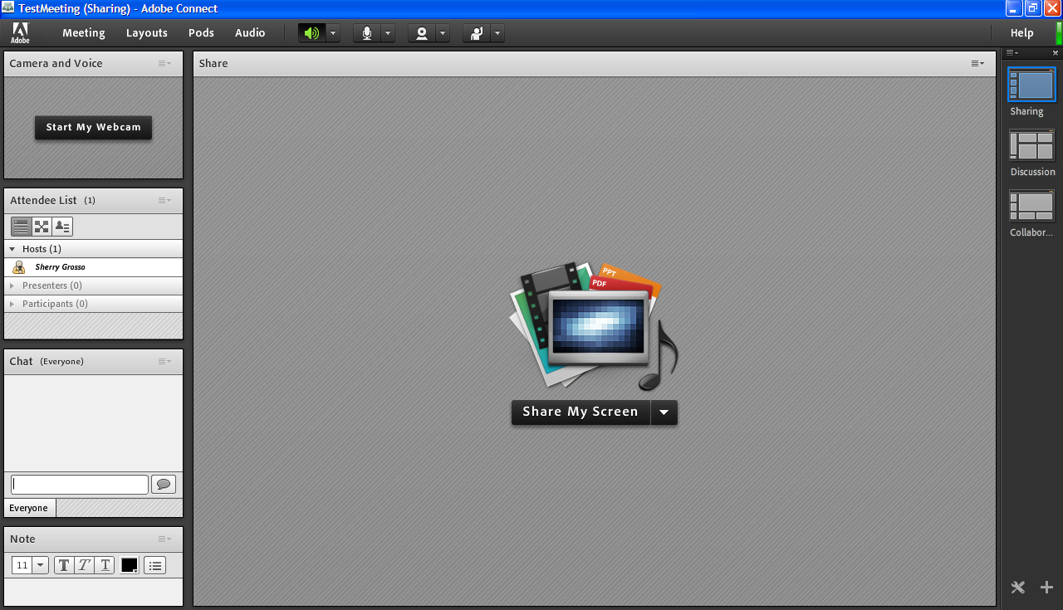
Adobe Connect
Cooperation

Slide 74
Good Practice Encourages Active Learning
Create “RLO’’s – Reusable Learning Objects
Topics not Chapters
Monitor student use metrics
Use Adaptive Release
Use student polls and surveys

Slide 75
Good Practice Encourages Active Learning
Use Discussion Assignments
The whole class or small groups
Require participation
Create discussion board prompts that involve interaction
Avoid asking yes/no questions
Avoid prompts that are based on purely factual answers

Slide 76
Good Practice Encourages Active Learning
Create posts that ask for reflection, interpretation, problem-solving, analysis
Create questions that solicit personal experiences and/or opinions
Create questions that require engagement with other classmates
Create prompts/questions that require connections to be made between previous and present course material

Slide 77
Good Practice Respects Diverse Talents and Ways of Learning
Many roads lead to learning

Slide 78
Good Practice Respects Diverse Talents and Ways of Learning
Vary the presentation of course materials
Narrated lectures
Videos
Readings/articles
Web links and activities
Guest speakers

Slide 79
Good Practice Respects Diverse Talents and Ways of Learning
Give students variety and choice in activities and assignments
Portfolios
Creative projects
Case studies
Interviews

Slide 80
Good Practice Respects Diverse Talents and Ways of Learning
Give students variety and choice in activities and assignments
Simulations
Puzzles
Games
Reflective Journals

Slide 81
Good Practice Respects Diverse Talents and Ways of Learning
Give students variety and choice in tasks and assignments
Blogs
Wikis
Videos
Podcasts
Mind maps

Slide 82
Good Practice Respects Diverse Talents and Ways of Learning
Provide varying degrees of difficulty
Provide variety in assessments
Assignments, quizzes, tests
Any assignment is a potential assessment
Provide many grades

Slide 83
Good Practice Respects Diverse Talents and Ways of Learning
Create an atmosphere of tolerance and respect through the content and tone of your course
Incorporate ADA standards and give information about availability of assistance

Slide 84
Your Successful Course
Be Flexible
Solicit Feedback
Be Willing to Make Revisions
Enjoy!

Slide 85
Sources
My Thanks To:
Bangert, A. (2004). The Seven Principles of Good Practice: A Framework for Evaluating Online Teaching. Internet and Higher Education, 7, 217-232.
Chickering, A., & Gamson, Z. (1987). Seven principles of good practice in undergraduate education. AAHE Bulletin, 39, 3-7
Chickering, A., & Reisser, L. (1993). Education and identity. San Francisco: Jossey-Bass.
Crews, T. B. (2011). Guide for Peer Reviewers of Online Courses. University of South Carolina College of Hospitality, Retail and Sport Management internal document.
Graham, C., Cagiltay, K., Lim, B., Craner, J. & Duffy, T. (2001). “Seven Principles of Effective Teaching: A Practical Lens for Evaluating Online Courses”. Technology Source 30.
Quality Matters:
http://www.qmprogram.org
USC Center for Teaching Excellence:
http://www.sc.edu/cte
Dr. Aisha Haynes, Instructional Designer, University of South Carolina Center for Teaching Excellence
Mike Brown, Instructional Designer, University of South Carolina Center for Teaching Excellence
Dr. Tena Crews, University of South Carolina and Stealth Consulting
Renee Shafer, Instructional Designer, University of South Carolina University Technology Services

